Slide 1


Introduction to
NonStop Tandem
Machines

Slide 2
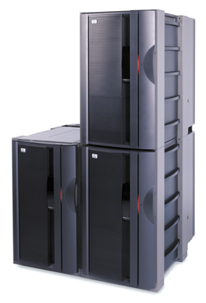
HP NonStop S76000/S86000 Server

Slide 3
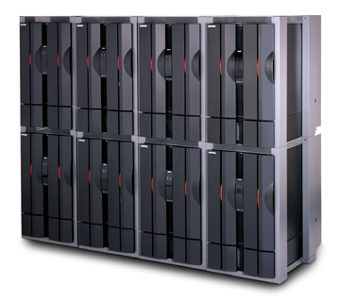
NonStop S74000 Server
(16-processor configuration)

Slide 4
Why NonStop Servers
Fault Tolerance & NonStop Availability
Data Integrity and Security
Data Distribution
Open Access
Application and system Expansion
Networking
High performance Uptime

Slide 5
Architecture Insides
Check point on process
Interconnected Multiple processors
Dual Access Path
Low Latency Routing( Wormhole routing)
Mirrored Disk
Multiple Power Source and Online Repairs
Detection and Correction of Hardware Errors
System Expansion
Parallel Processing

Slide 6
Check Point
Primary Process
Backup Process
Check Point
Disk

Slide 7
Interconnected processors
CPU 0
CPU 1
Server Net A
Server Net B

Slide 8
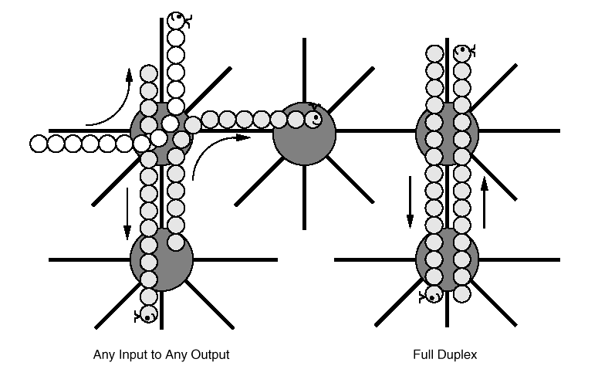
Low Latency Routing

Slide 9
Software Fault Tolerance
Process Pairs
Persistent Processes
TMF

Slide 10
NonStop Systems Available
K Series Servers
S Series Servers
Blade Servers

Slide 11
NonStop Kernel (NSK)
NSK is the Operating System for the NonStop Servers
D Series Operating System
G Series Operating System

Slide 12
Logging On
The Non-Stop Kernel identifies users by means of logon procedure. Every user must enter a valid user ID and password to obtain access to the system.
Logging on to the system allows you to communicate with TACL at your terminal
TACL 1> LOGON GROUP.USER (Need not be case-sensitive)
Password: (String of 1-8 Characters And Case-Sensitive)

Slide 13
Logging Off
60> LOGOFF
OR
60> EXIT

Slide 14
Guardian Environment
NSK operating system users interact with their systems in the Guardian Environment
The Guardian Environment contains many programs, tools & utilities

Slide 15
What is TACL?
Tandem Advanced Command Language (TACL) is the command interface in the Guardian Environment

Slide 16
File Naming
A fully qualified file name is of the form
[node-name(system-name)].[vol-name].[subvol-name].file-id

Slide 17
The Node name
Node name is the name of the system
Begins with a backslash (\)
Example: \NODE1

Slide 18
The Volume name
This is the physical disk volume where the file resides
Begins with a dollar sign ($), followed by 1 to 7 alphanumeric characters
Example: $DISK2

Slide 19
The Subvolume name
This is a set of files in the same disk volume
Begins with a letter
1 to 8 alphanumeric characters
Example: SUBVOL3

Slide 20
The File Identifier
This is the name of an individual file
Begins with a letter
1 to 8 alphanumeric characters
Example: MYFILE4

Slide 21
File Name Examples
\NODE1.$DISK2.SUBVOL3.MYFILE4
$DATA002.PROJECT.FILE1
MYFILES.TESTPROG
TESTOBJ

Slide 22
File Code
The file code identifies the type of file
Edit files have file code 101

Slide 23
Guardian File Security
Each file is assigned a security specifier RWEP for Read, Write, Execute & Purge access
Security can be:
O : Owner
G : Group
A : Anyone
- : Super ID
U : User
C : Community
N : Network

Slide 24
Process Name & Cpu, pin
Each running process is identified by cpu, pin
cpu identifies the processor on which the process is running
pin (Process Identification Number) identifies the particular process on the cpu
Process may optionally have a Process Name

Slide 25
Starting a Process
The RUN command
$VOL SUBVOL 2> RUN $SYSTEM.SYSTEM.TEDIT
$VOL SUBVOL 3> RUN MYOBJ /NAME $ME/

Slide 26
Stopping a Process
The STOP command
$VOL SUBVOL> STOP 0, 100
$VOL SUBVOL> STOP $XYZ

Slide 27
Editors Available
Text EDIT (TEDIT) is a full screen editor for the Guardian Environment
Another editor available is EDIT.
EDIT is a line editor

Slide 28
What is FUP?
The File Utility Program (FUP) is used for file management
Enscribe files are created using FUP

Slide 29
What is OSS?
Open System Services (OSS) is an Open System Environment available for interactive or programmatic use with the NSK operating system

Slide 30
Databases Available
Enscribe
NonStop SQL

Slide 31
OLTP Environments Available
Pathway/TS (& Pathway/iTS)
NonStop TUXEDO

Slide 32
What is native & non-native?
Native code (TNS/R)
Non-native code (TNS)

Slide 33
Programming Languages Available
TACL
TAL / pTAL
C / C++
COBOL85
SCREEN COBOL
PASCAL
FORTRAN
JAVA

Slide 34
Useful Links
TIM
  Introduction to Tandem Himalaya S Series
http://h30163.www3.hp.com/NTL/library/G06_RVUs/G06_24/Publications/index.asp

Slide 35
Thank You

